Slide 1
Spectrogram Reading
Group 5

Slide 2
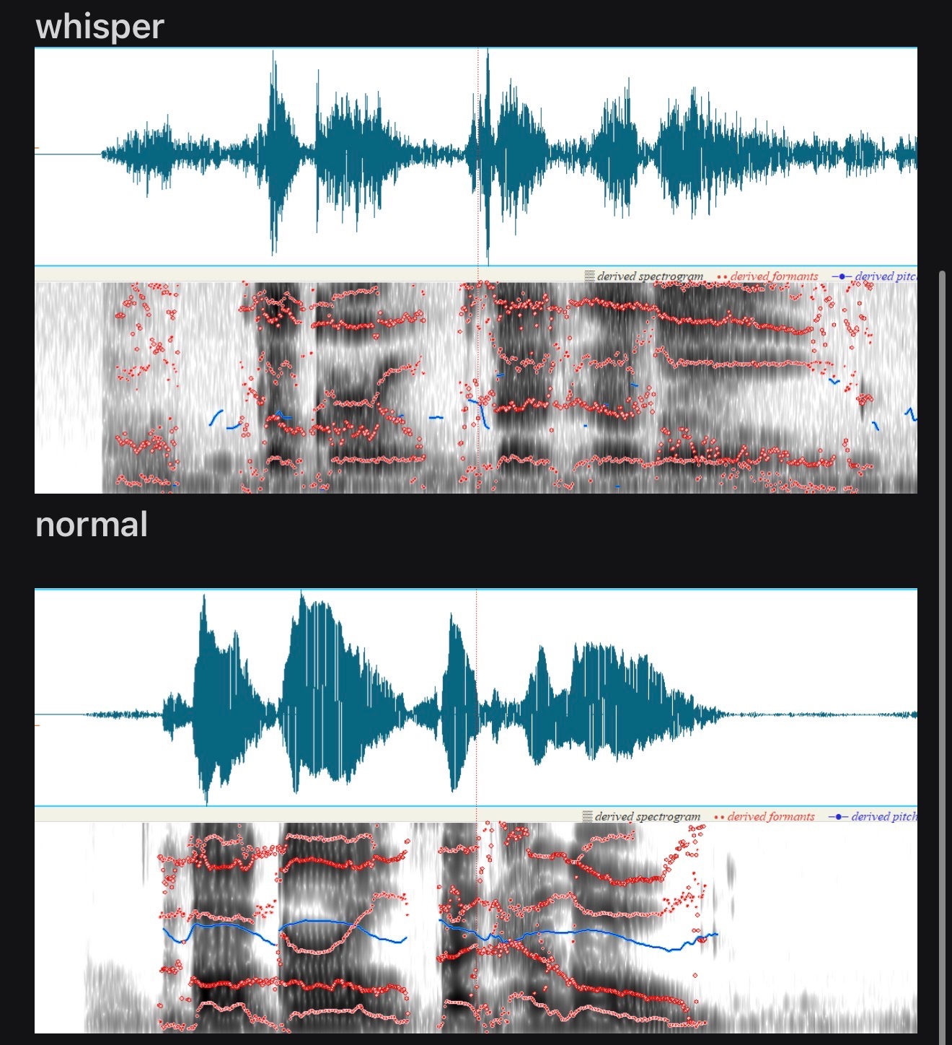
T_e g_rl _a_d h_ll_
Notes:
Normal

Slide 3
Which is said normally and which is said whispering?
Notes:
LEFT: Whisper
RIGHT: Normal

Slide 4
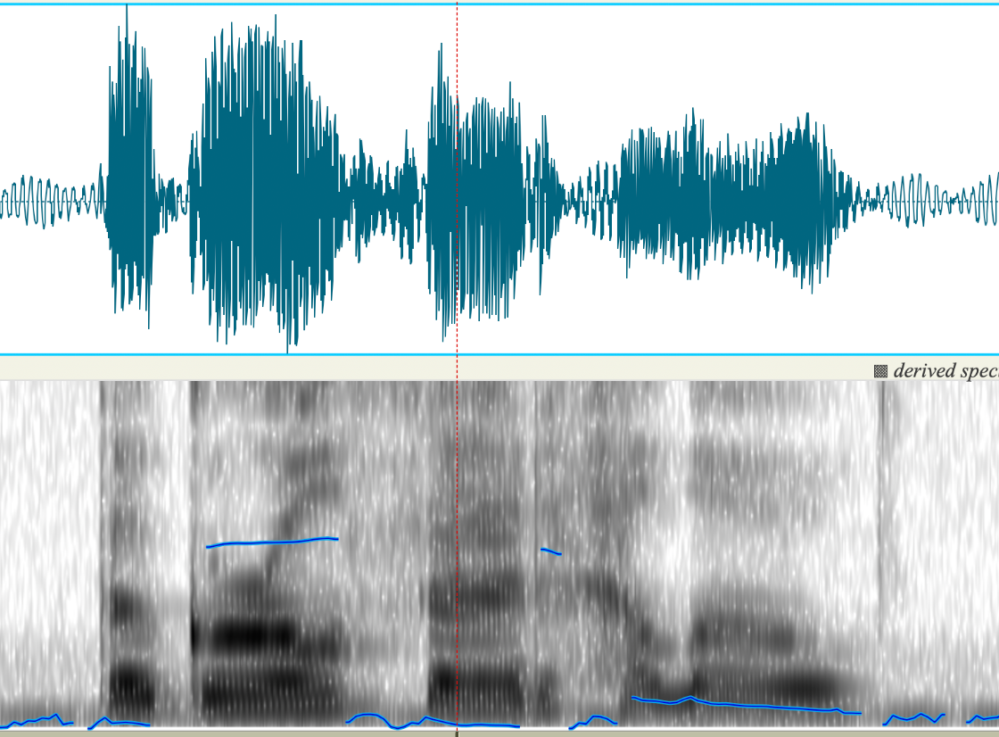
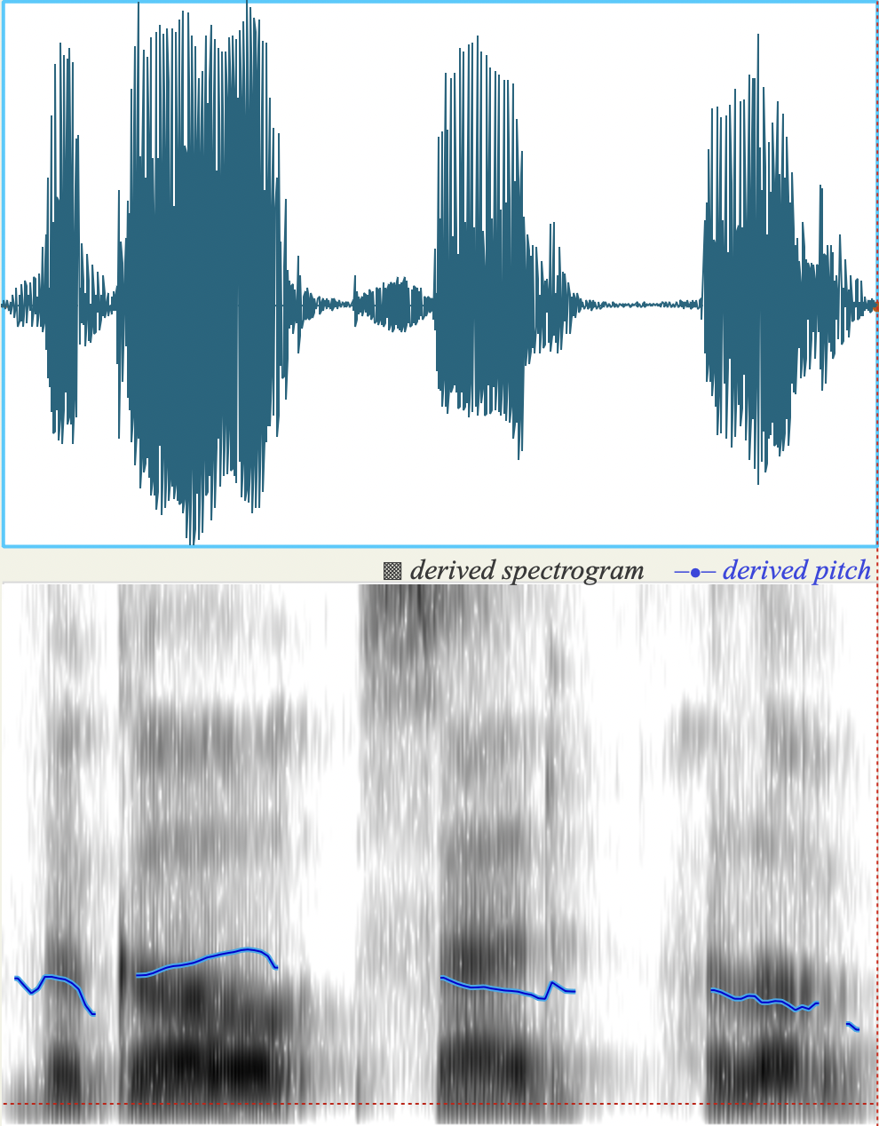
What about female vs male?
Avg F0: 221 Hz
F3: 2964 Hz
Avg F0: 107.5 Hz
F3: 2733.4 Hz
Formants pulled down

Slide 5
Avg F0: 201 Hz
F3: 1512.2 Hz

Slide 6
Summary of findings
F0 and formant spacing clearly distinguish male vs female

